Slide 1
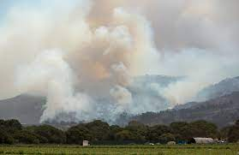
WILDFIRE REGIME IN THE CARMEL RIVER WATERSHED
Presented by Erika Garig in relation to CSUMB Environmental Science Program in spring of 2022

Slide 2
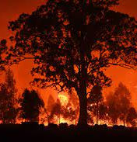
Key Terms
Fire Regime: the patterns of fire seasonality, frequency, size, spatial continuity, intensity, type (e.g., crown or surface fire) and severity in a particular area. In our case we will be focusing on fire frequency.
Fire Frequency: the number of fires within a specific time
Fire Return Interval: the amount of time between fires, there is an expected and an observed fire return interval

Slide 3
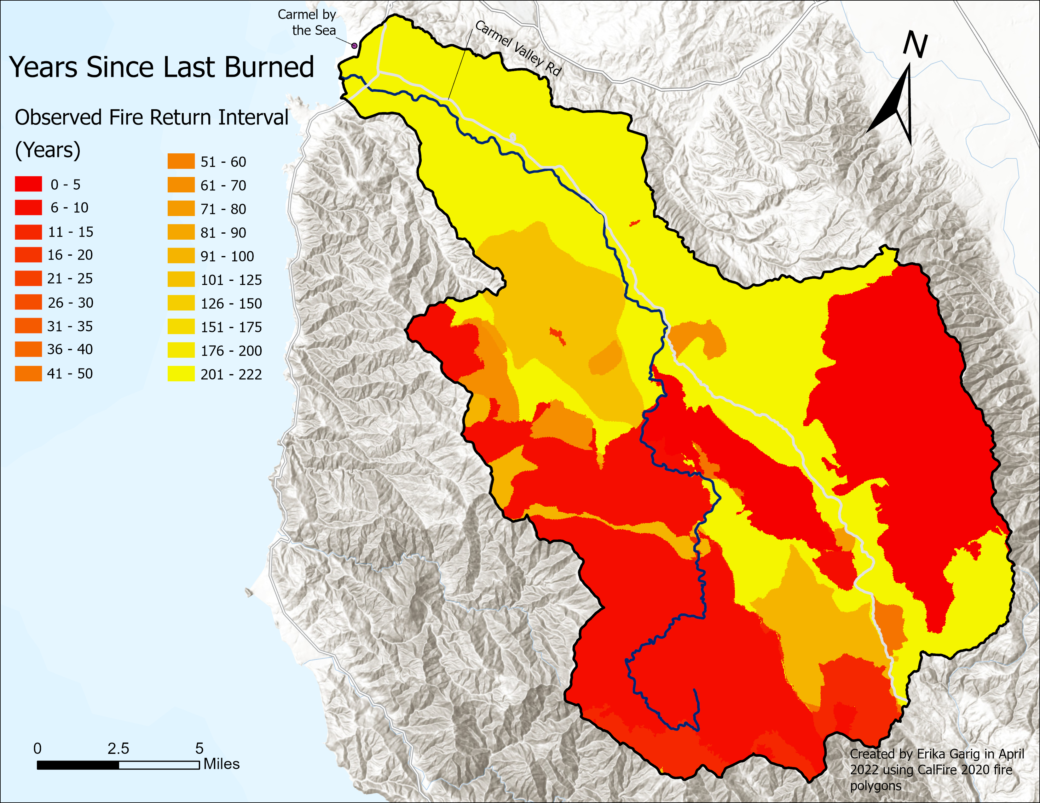
Map 1: The observed fire return interval from CalFire within the Carmel River watershed with the more recently the watershed has been burned.

Slide 4
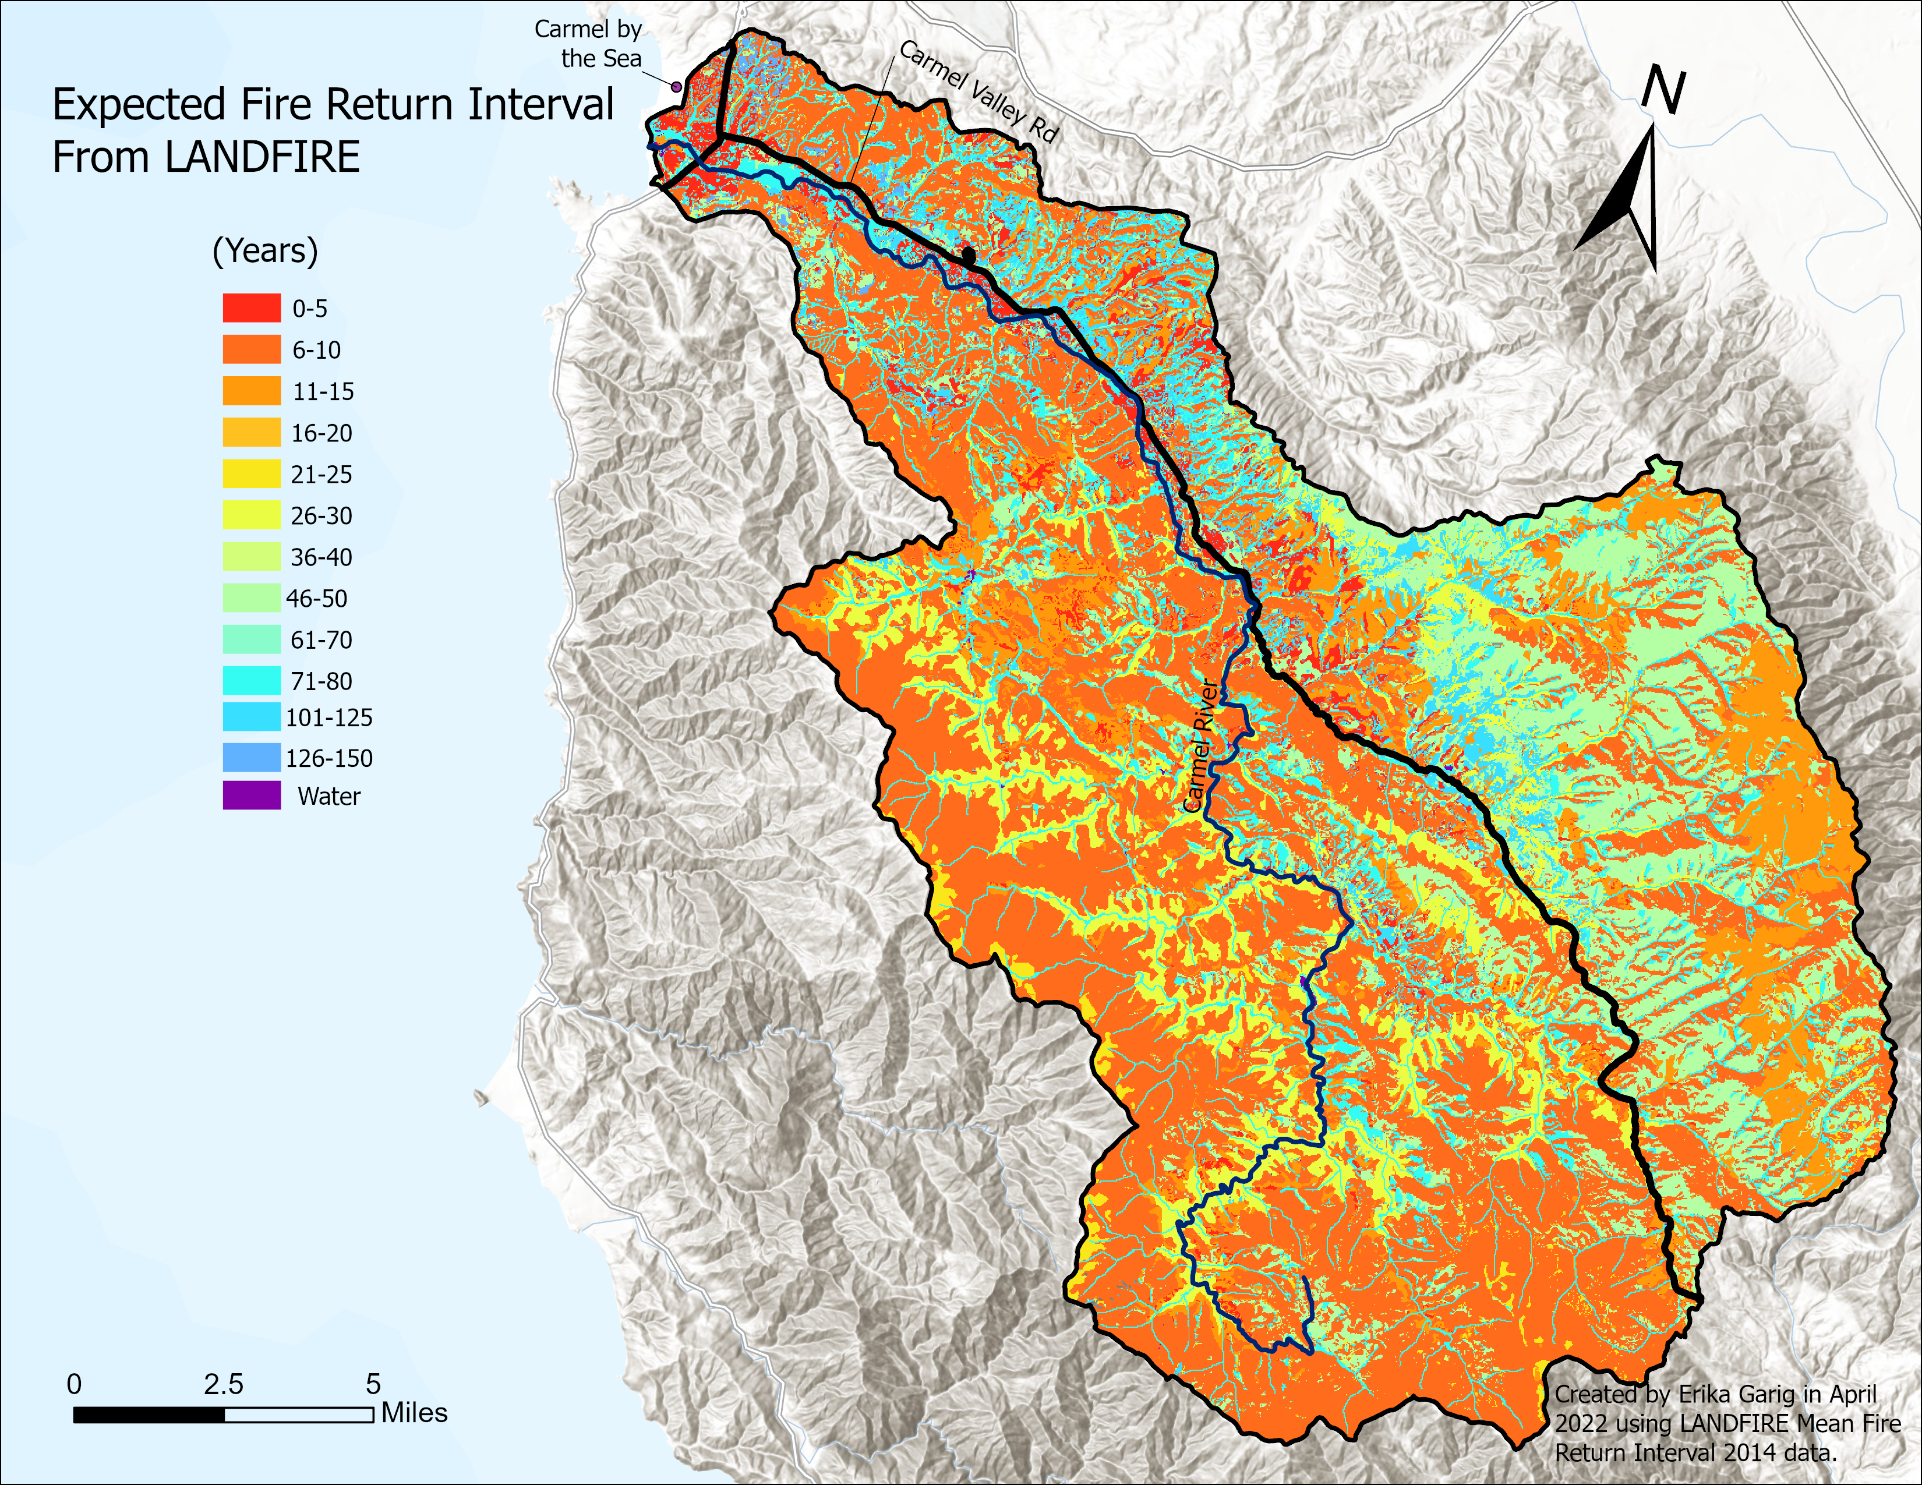
Map 2: This shows the expected fire return interval from LANDFIRE within the Carmel River watershed. The orange or red colors indicates a shorter fire return interval and the bluer colors indicate a longer fire return interval

Slide 5
How to Calculate the Carmel River Watershed’s Fire Return Interval
We take observed (Map 1) minus expected (Map 2) to determine which portion of the watershed is within the expected fire return interval.
Map 3 is the difference between Map 1 and Map 2 to show the deviation from the expected fire return interval
We then calculated the percent of area within the expected fire return interval

Slide 6
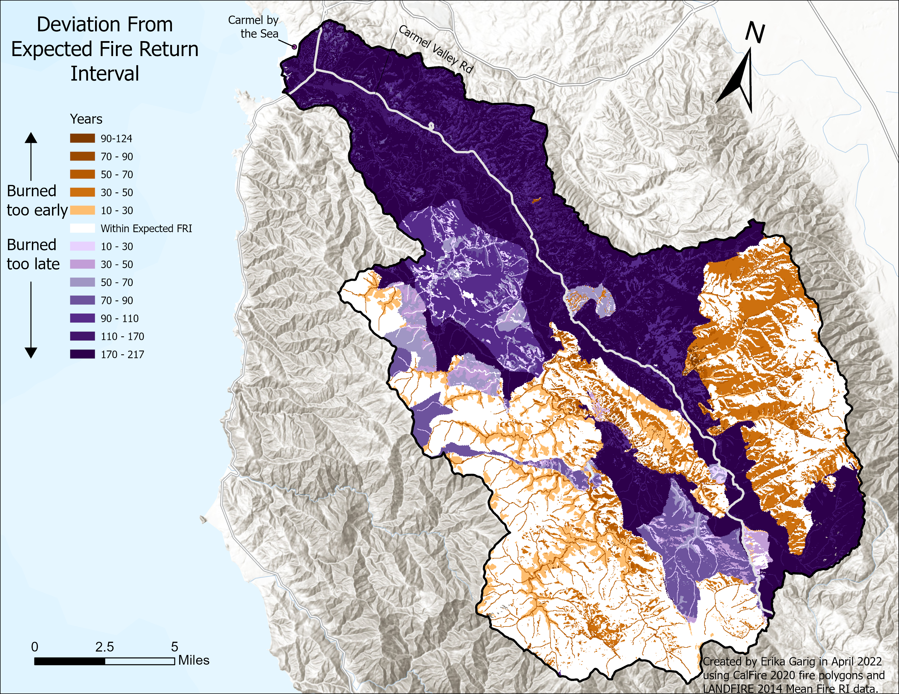
Map 3: Is the difference between Map 1 and Map 2 which means that all the areas in brown tones burned sooner than expected and all the areas in blue-violet burned later than expected. White is exactly within the fire return interval.

Slide 7
29% of the Carmel River Watershed Falls Within the Expected Fire Return Interval

Slide 8
Fire Implications
The areas that have burned too late or not at all are primarily located within the infrastructure regions of Carmel.
The areas that have burned too early are generally in some of the areas that were burned recently from the two big fires in 2020.

Slide 9
Fire Regime Suggestions
In these areas that have either burned too late or not at all we should maybe do some form of fire fuel reduction projects maybe hand thinning, mastication, or controlled burns.
Add burn severity into the index, would require additional data to find different fire reports because currently there is not a BAER report on 2020 fires.

Slide 10
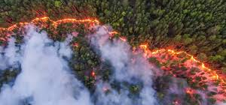
Questions for the Fire Portion?

Slide 11
Fire Regime Citations
Fire Perimeters (2020) [File geodatabase feature class]. CALFIRE. Resource URL: https://frap.fire.ca.gov/mapping/gis-data/
LANDFIRE, 2014 Mean Fire Return Interval, (2014) [Raster] LANDFIRE 2.0.0, U.S. Department of the Interior, Geological Survey, and U.S. Department of Agriculture. Accessed 28 October 2021 at http://www.landfire/viewer.

Slide 12
Landcover Classification Systems
In part taken from my presentation for Advanced GIS which was on May 4th, 2022

Slide 13
Introduction
I ran an analysis on 4 land cover classification systems, one of which was my own, and the three others were LANDFIRE, CALVEG, and NLCD
Done on the Carmel River watershed boundary to see which one most accurately portrayed the watershed using confirmation vegetation points

Slide 14
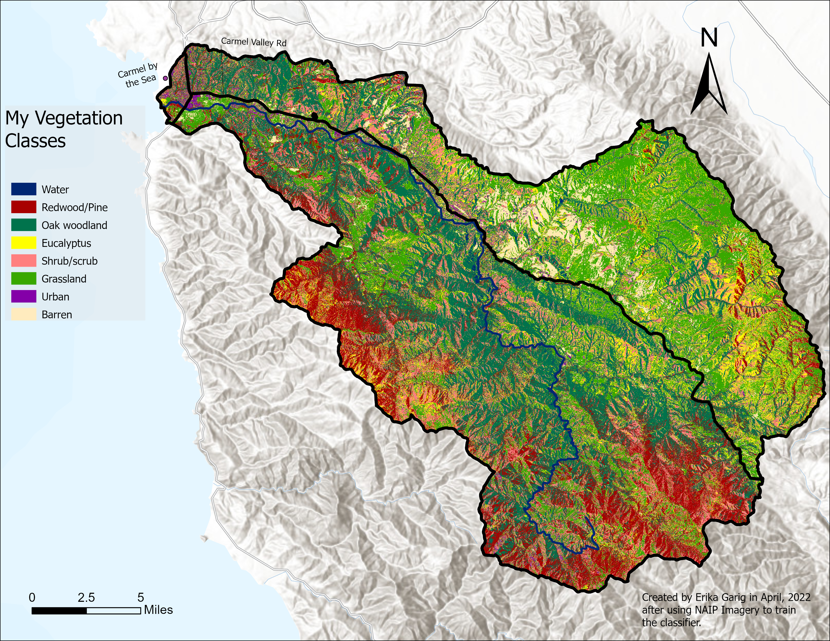

Slide 15
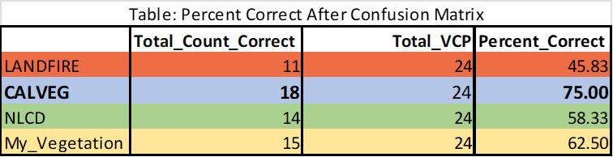
Results: CALVEG Did the Best

Slide 16
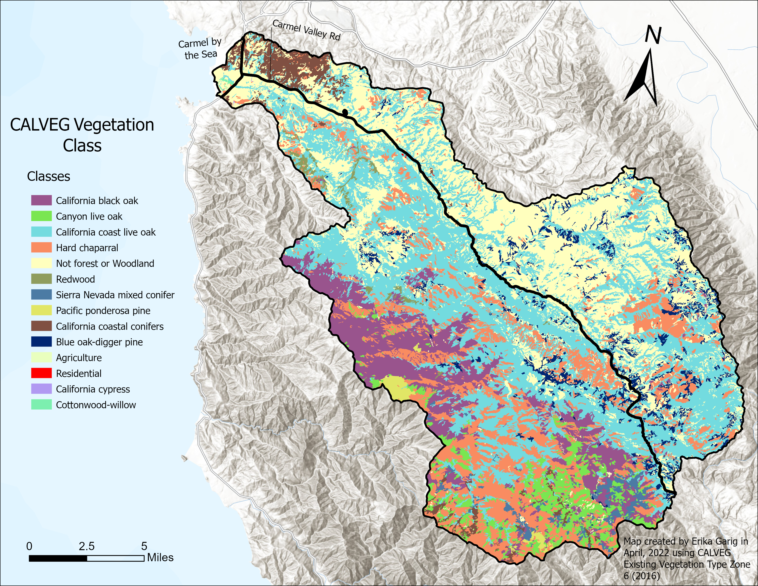

Slide 17
Pros and Cons of Each
Con for all of them none of them use data that is newer than 2019
Pros +
Cons -
LANDFIRE:
CALVEG:
NLCD:
My Vegetation:
Very detailed for the nation
Area specific for native trees ☺
Simple
Shows a common invasive species
Too detailed for California
Needs to differentiate b/w shrubs and grass
Too simple perhaps
Needs more training polygons
Notes:
Give example of Rocky Mountain Subalpine-Montane Mesic Herbaceous Meadow for LF

Slide 18
Possible Implications/Suggestions
Maybe make a classification system that has most of CALVEG classes but also has a grassland class, and a couple big invasive tree species such as eucalyptus
The watershed could have possibly had more eucalyptus in the Southeast corner where the 2020 fires occurred because all the classification systems were from 2016-2019 data
  My Vegetation classification system specifically used NAIP 2016 data

Slide 19
References
Existing Vegetation- CALVEG,1998-2015 [ESRI personal geodatabase- polygon]. (2016). McClellan, CA: USDA-Forest Service Region 5 Central Coastal Zone 6. [April 2022]. Resource URL: https://apps.fs.usda.gov/arcx/rest/services/EDW/EDW_ExistingVegetationRegion05_01/MapServer
LANDFIRE, 2016 Existing Vegetation Type Layer, (2016) [Raster] LANDFIRE 2.0.0, U.S. Department of the Interior, Geological Survey, and U.S. Department of Agriculture. Accessed 28 October 2021 at http://www.landfire/viewer.
NLCD Land Cover (CONUS) All Years (2019) [Raster]. Multi-Resolution Land Characteristics Consortium (MRLC). Resource URL: https://www.mrlc.gov/data?f%5B0%5D=category%3ALand%20Cover

